Slide 1

Streamlining Email Classification in
Crime Investigation Department
Team Leader:
Garima Chandna (102017070)
Members:
Rashmeet Kaur (102017065)
Simranjit Kaur (102017060)
Aakanksha Pandey (102017059)

Slide 2

Project Overview
Focused on streamlining the complaint classification process in CID.
Reduce the workload of investigators.
Categories - missing person, molestation, murder, rape, theft.

Slide 3







Need Analysis
Manual Process
Time Consuming
Error Prone

Slide 4








Problem Statement and Objectives
DATA ACQUISITION
COMPLAINT CLASSIFICATION MODEL
WEBSITE

Slide 5
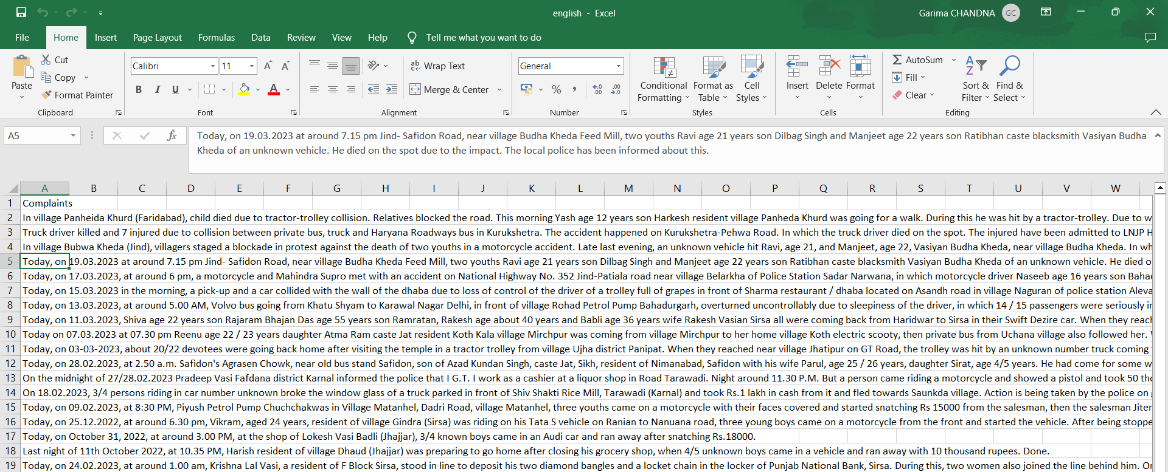
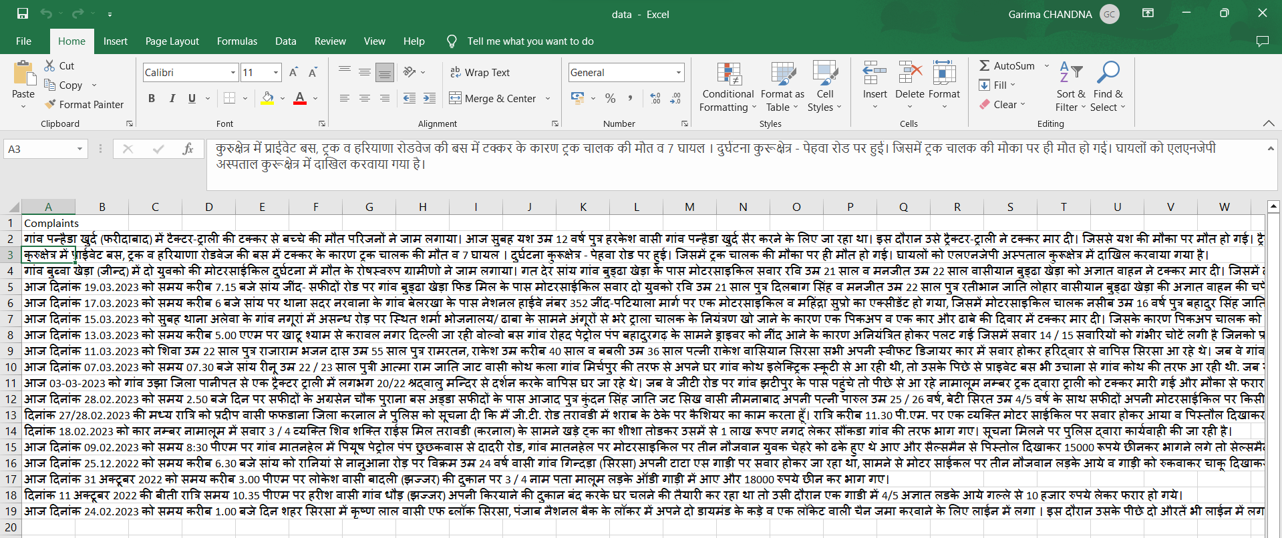
Data Translation

Slide 6
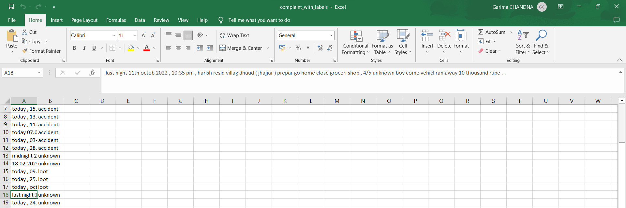
Labelled Data

Slide 7
Project Outcomes
Complaint Email Classification Model- to classify complaint emails based on their content.
Website- A website will be developed that will integrate the complaint classification model.

Slide 8

Literature Survey
Ref | Model | .Author(s) | Novelty | Feature Extraction | Details | Validation Measure | Limitation
[1] | Logistic Regression | A. Genkin | Logistic regression analysis of high-dimensional data | TF-IDF | It is based on Gaussian Priors and Ridge Logistic Regression | F1-Macro | Prediction outcomes is based on a set of independent variables
[2] | Naïve Bayes | Kim, S.B. | Multivariate poisson model for text Classification | Weights words | Per-document term frequency normalization to estimate the Poisson parameter | F1-Macro | This method makes a strong assumption about the shape of the data distribution
[3] | SVM and KNN | K. Chen. | Introduced TFIGM (term frequency & inverse gravity moment) | TF-IDF and TFIGM | Incorporates a statistical model to precisely measure the class distinguishing power of a term | F1-Macro | Fails to capture polysemy and also still semantic and sentatics is not solved
[1] Genkin, Alexander, David D. Lewis, and David Madigan. "Large-scale Bayesian logistic regression for text categorization." technometrics 49.3 (2007): 291-304.
[2] Kim, Sang-Bum, et al. "Some effective techniques for naive bayes text classification." IEEE transactions on knowledge and data engineering 18.11 (2006): 1457-1466.
[3] Chen, Kewen, et al. "Turning from TF-IDF to TF-IGM for term weighting in text classification." Expert Systems with Applications 66 (2016): 245-260.

Slide 9


Literature Survey
[4] | Conditional Random Field (CRF) | T. Chen et al. | Apply a neural network based sequence model to classify opinionated sentences into three types according to the number of targets appearing in a sentence | Word embedding | Improve sentence-level sentiment analysis via sentence type classification | Accuracy | High computational complexity and this algorithm does not perform with unseen words
[5] | Deep Learning | Z. Yang et al. | It has a hierarchical structure | Word embedding | Two levels of attention mechanisms applied at the word and sentence-level | Accuracy | Works only for document-level
[4] Chen, Tao, et al. "Improving sentiment analysis via sentence type classification using BiLSTM-CRF and CNN." Expert Systems with Applications 72 (2017): 221-230.
[5] Yang, Zichao, et al. "Hierarchical attention networks for document classification." Proceedings of the 2016 conference of the North American chapter of the association for computational linguistics: human language technologies. 2016.

Slide 10


